Slide 1
DDCO Project
Simulating an ALU using Logisim
By: Gopal Nambiar, Hithendra Narasimha, Karthik Ravikumar, Kunal Paliwal

Slide 2
Logisim
Logisim is a logic simulator which permits circuits to be designed and simulated using a graphical user interface. Released under the GNU Public License, Logisim is a free software designed to run on Windows, mac and Linux operating systems. Circuits are designed in Logisim using a graphical user interface similar to traditional drawing programs. Unlike other simulators, Logisim allows the user to edit the circuit during simulation. We have used it to simulate an ALU.

Slide 3
Logisim
Features:
Free software
Multi-platform
The drawing interface is based on an intuitive toolbar. Color-coded wires aid in simulating and debugging a circuit.
Included circuit components include inputs and outputs, gates, multiplexers, arithmetic circuits, flip-flops, and RAM memory.
The included "combinational analysis" module allows for conversion between circuits, truth tables, and Boolean expressions.

Slide 4
ALU
An arithmetic logic unit (ALU) is a combinational digital electronic circuit that performs arithmetic and bitwise operations on integer binary numbers. This is in contrast to a floating-point unit (FPU), which operates on floating point numbers. An ALU is a fundamental building block of many types of computing circuits, including the central processing unit (CPU) of computers, FPUs, and graphics processing units (GPUs). A single CPU, FPU or GPU may contain multiple ALUs.
The inputs to an ALU are the data to be operated on, called operands, and a code indicating the operation to be performed; the ALU's output is the result of the performed operation. In many designs, the ALU also has status inputs or outputs, or both, which convey information about a previous operation or the current operation, respectively, between the ALU and external status registers.

Slide 5
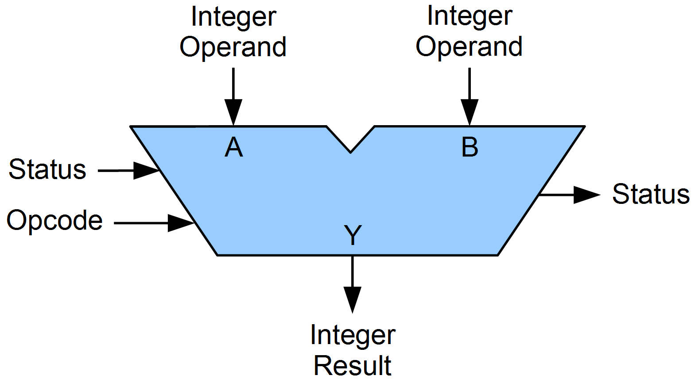
Arithmetic & Logic Unit
A symbolic representation of an ALU and its input and output signals, indicated by arrows pointing into or out of the ALU, respectively. Each arrow represents one or more signals. Control signals enter from the left and status signals exit on the right, data flows from top to bottom.

Slide 6
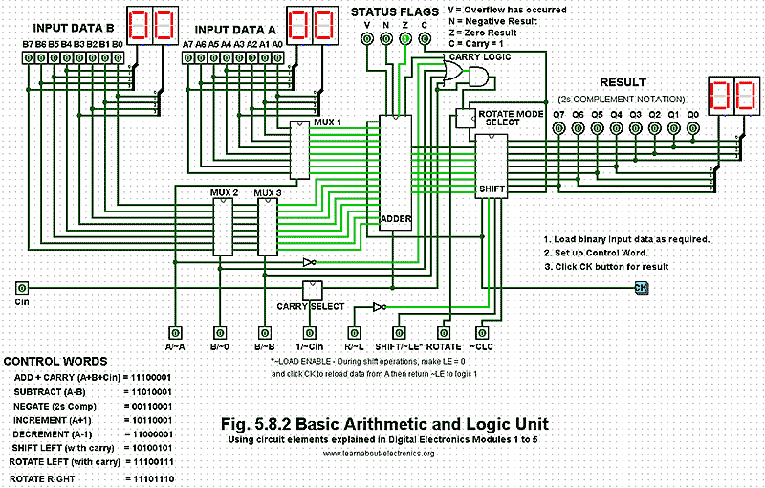
ALU using Logisim
Components:
3 Multiplexers
8-Bit Adder
Shift Register
Carry Logic and Rotate Select

Slide 7
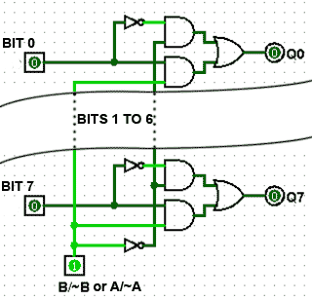
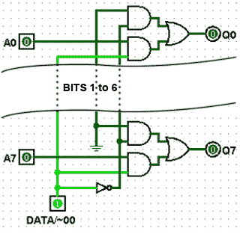
ALU using Logisim
Components:
1. 3 Multiplexers: MUX 1 and MUX 3 are identical 8 bit multiplexers that select either the input data word A (MUX 1) or data word B (MUX 3) or their internally generated complement. MUX 2 is a similar design but selects either the data word B or the zero value 00HEX.
MUX1 and MUX3
MUX2

Slide 8
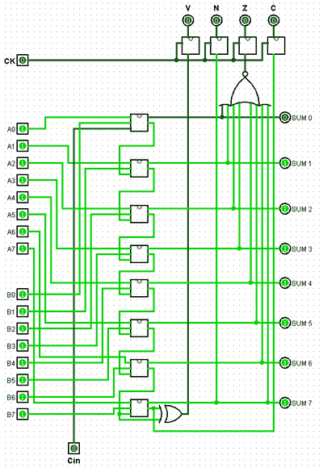
ALU using Logisim
Components:
2. 8-bit Adder : The 8-bit adder component is a 8-bit ripple carry adder, real ALUs would normally have a carry-lookahead adder for high-speed operation. However for this example the much simpler ripple carry adder is adequate, as the operation is totally manual.

Slide 9
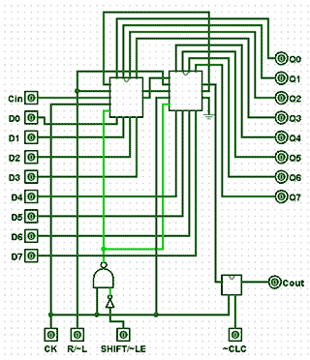
ALU using Logisim
Components:
3. Shift Register : This component uses two 4-bit shift registers connected in cascade. Inputs are provided for clock pulses, (CK), a right/left shift control (R/~L) and an input to control whether the shift register is in shift, or load-enable modes (SHIFT/~LE). If ~LE is chosen temporarily during shift operations, the shift register can be reloaded from the data placed on the 8-bit ‘Data A’ and ‘carry-in’ (C_{IN}) inputs. This action is synchronised to the CK pulse by the external NAND and NOT gates connecting the SHIFT/~LE input to the two ~LOAD inputs of the 4-bit shift registers. An additional JK flip-flop (mimicking a D type flip-flop) is placed between the ‘serial-right’ output of the shift register and C_{OUT} to allow the ‘clear carry’ input (~CLC) to clear the carry flag.

Slide 10
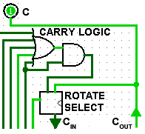
ALU using Logisim
Components:
3. Carry Logic and Rotate Select: The carry logic circuit prevents the carry flag being set in rotate right mode, as bits rotate from bit 0 and re-enter the shift register at bit 7, therefore allowing correct carry flag operation in both left and right rotate modes. When the ROTATE input is at logic 1, the Rotate Select circuit allows C_{OUT} from the shift register to be fed back to the shift register C_{IN} input for continuous bit rotation.

